Slide 1

By Erin Green, Mary Moore, Robert Book, Keiran Berry, and Oliver Schwab ​

Slide 2
🔥 Intro to Mojo 🔥
Language Release: May 2023
Current Version: 0.6.0
Philosophy:
Enhance Python’s usability with C’s performance
Make it simple to use Python libraries and existing code
Allow programmer to decide to use static or dynamic typing
Simplify AI/ML programming
Scalable programming model
Target systems that are pervasive in AI field

Slide 3
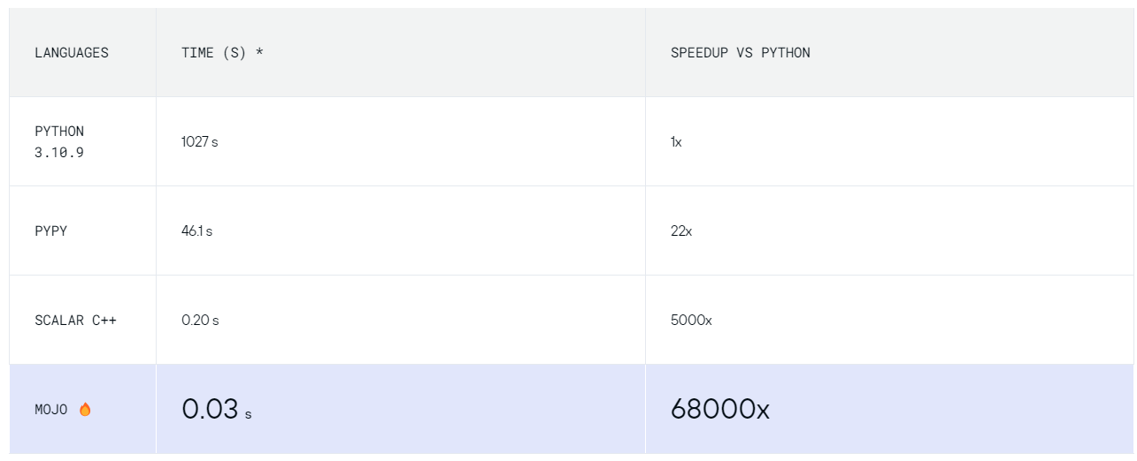
🔥 Why Use Mojo? 🔥
Faster
Parallel processing
Very similar syntax to Python
Ability to import Python modules
https://www.modular.com/max/mojo

Slide 4
🔥 Where to use Mojo 🔥
AI development
Large, processor heavy projects
Improve performance of Python Projects

Slide 5
🔥 Mojo Usage 🔥
Immutable
def zoo(x: Int):
let z: Float32
if x != 0:
z = 1.0
else:
z = foo()
print(z)
no classes
fn main():
print("Hello, world!")
var count: Int = 0
while count < 10:
zoo(count)
fn repeat[count: Int](msg: String):
for i in range(count):
print(msg)
fn call_repeat():
repeat[3]("Hello")
compiler can optimize the function because count is guaranteed to not change at runtime
compiler generates a unique version of repeat that loops 3 times
less to compute at runtime ⇒ faster code
struct MyPair:
var first: Int
var second: Int
fn __init__(inout self, first: Int, second: Int):
self.first = first
self.second = second
fn get_sum(self) -> Int:
return self.first + self.second
mutable
fn foo(x: Int) -> Float32:
for y in range(9, 0, -3):
try:
return x / y
except:
return 0.0
return 3.14
parameterization
no inheritance
Notes:
since mojo is a superset of & aims to be fully compatible with python, their syntax are very similar
some differences/specialties include:
functions can be defined with either def (like python) or fn, def gives dynamic, flexible functions like in Python, but fn enforces type-declarations and memory safe behaviors, like Rust
variables are defined with let or var
classes are not a thing, but they’re in the plan for the future; however, right now there are structs which act effectively as static classes without inheritance
functions can also have parameters, which are different from arguments and are specified in brackets not parentheses and allow for compile-time metaprogramming, a focus of Mojo for their work in AI

Slide 6
🔥 Mojo Usage 🔥
1
hello.mojo
mojo hello.mojo
program.🔥
🔥
2
mojo build program.🔥
./program
Notes:
to run a mojo project, you can either run a file similar to how you would in python or you can build an executable similar to what you might remember doing in C++
file extension in mojo are kinda fun too, you may have noticed the fire emoji around our presentation a lot…
mojo files can either have a .mojo extension or a .🔥 extension!
(and mojo packages can either be .mojopkg or .📦)

Slide 7
🔥 The Problem 🔥
Create a Connect 4 AI
First we have to make the Connect Four Game
Then we have to create AI to interface with and play the game

Slide 8
🔥 Program Functionalities 🔥
Game
Menu - Oliver
History - Oliver
Board - Keiran
Array - Keiran
File Output - Mary
Command Line Output - Mary
AI
Easy AI - Erin
Hard AI - Erin
Medium AI - Robert
AI vs AI - Robert

Slide 9
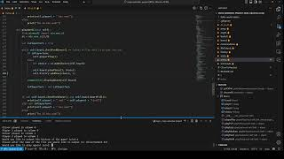
🔥 Code Example 🔥

Slide 10
🔥 Do we recommend Mojo? 🔥
No.
Absolutely Not.

Slide 11
🔥 Why Not? 🔥
Its current state is riddled with issues
Portability is Abysmal
Little support and outside resources
Too underdeveloped to be competitive with other languages
However, the future carries hope
The current issues Mojo has are due to its age

Slide 12
"You shoot yourself in the foot, but first you have to invent the gun. All you have is three pages of instructions, a sheet of metal, and a toy hammer. Once you build your gun, you receive numerous complaints about the type of bullet you can use. Finally, you find the singular correct bullet to put in the gun. Once you've shot yourself in the foot, you realize that your three pages do not include medical instructions, leaving you to die. But by then, you only long for the sweet release of death, realizing that the 🔥 extension stands for the pits of hell themselves."

Slide 13
🔥 Thank You! 🔥 ​

